Slide 1
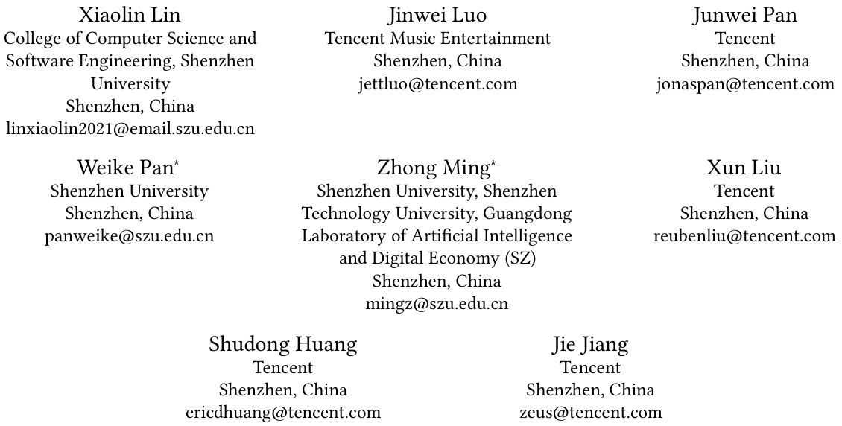
Chongqing University of Technology
ATAI
Advanced Technique of Artificial Intelligence
Chongqing University of Technology
Multi-Sequence Attentive User Representation Learning for Side-information Integrated Sequential Recommendation
Code：https://github.com/xiaolLIN/MSSR
—— WSDM 2024
2024.3.24 • ChongQing
Reported by Peng Shan

Slide 2
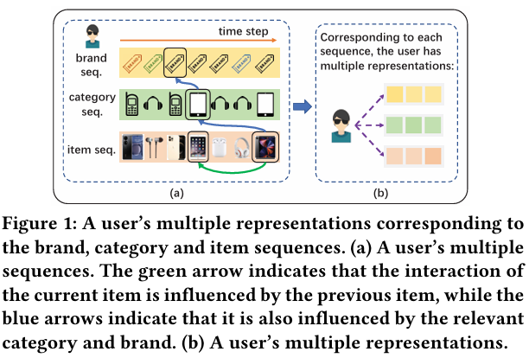
Motivation
（1）Most of existing works only focus on the attention within a single sequence and overlook the intrinsic association of entities from distinct sequences, such as the attention between a category and a brand.
（2）However, existing works have not adequately addressed the need for more supervision signals when optimizing the multiple representations learned from the same user.

Slide 3
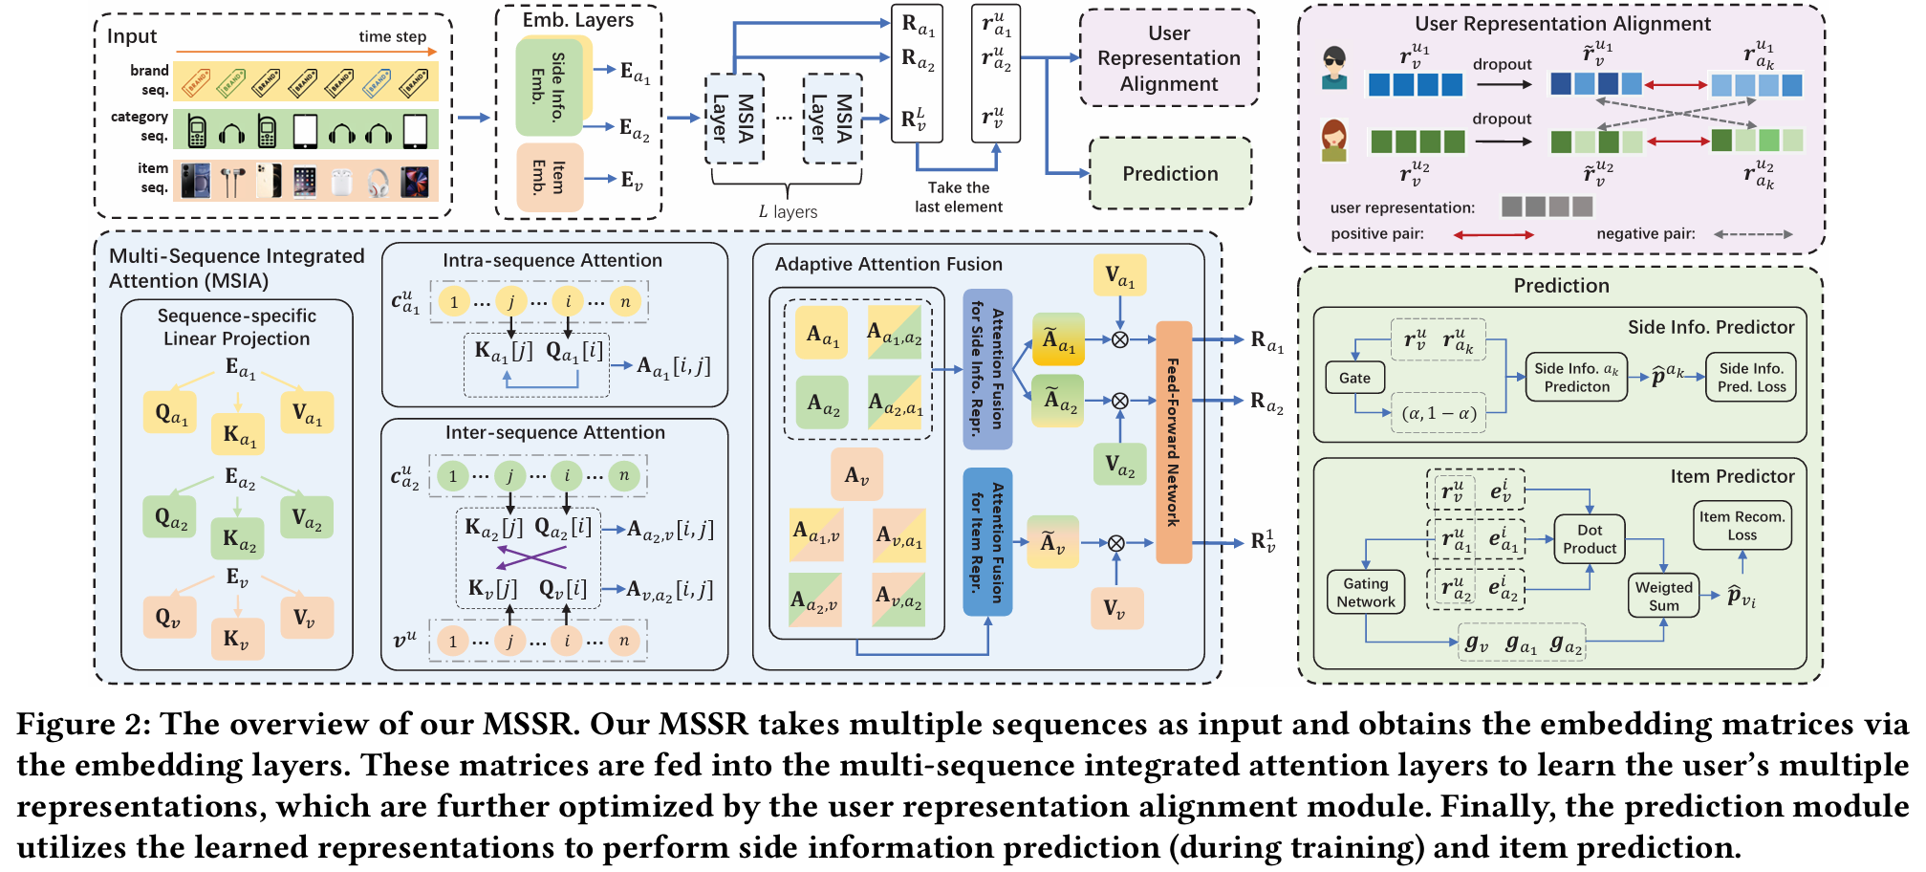
Method

Slide 4
Method

Slide 5
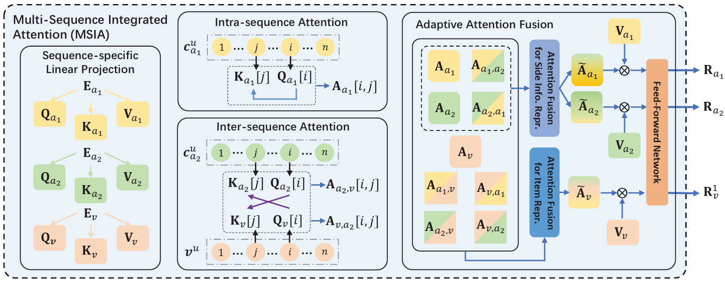
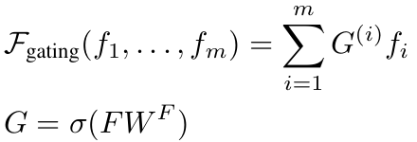
Method

Slide 6
Method

Slide 7
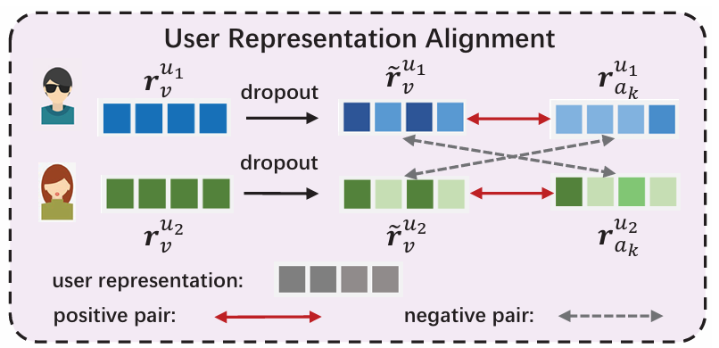
Method

Slide 8
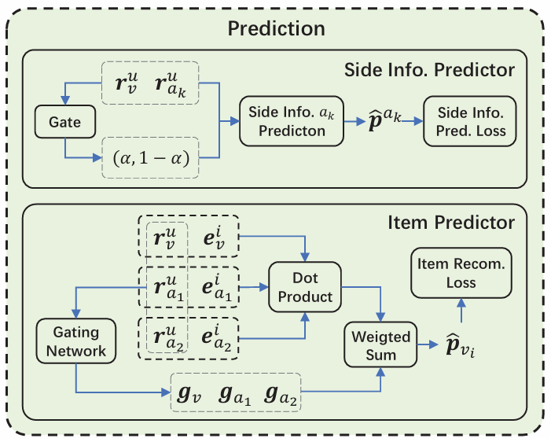
Method

Slide 9
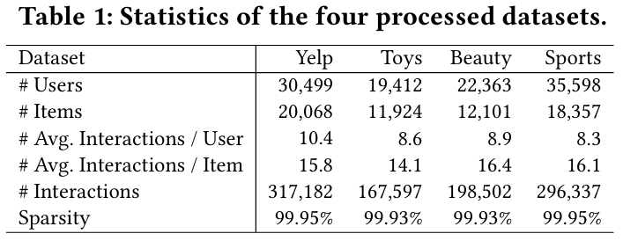
Experiments

Slide 10
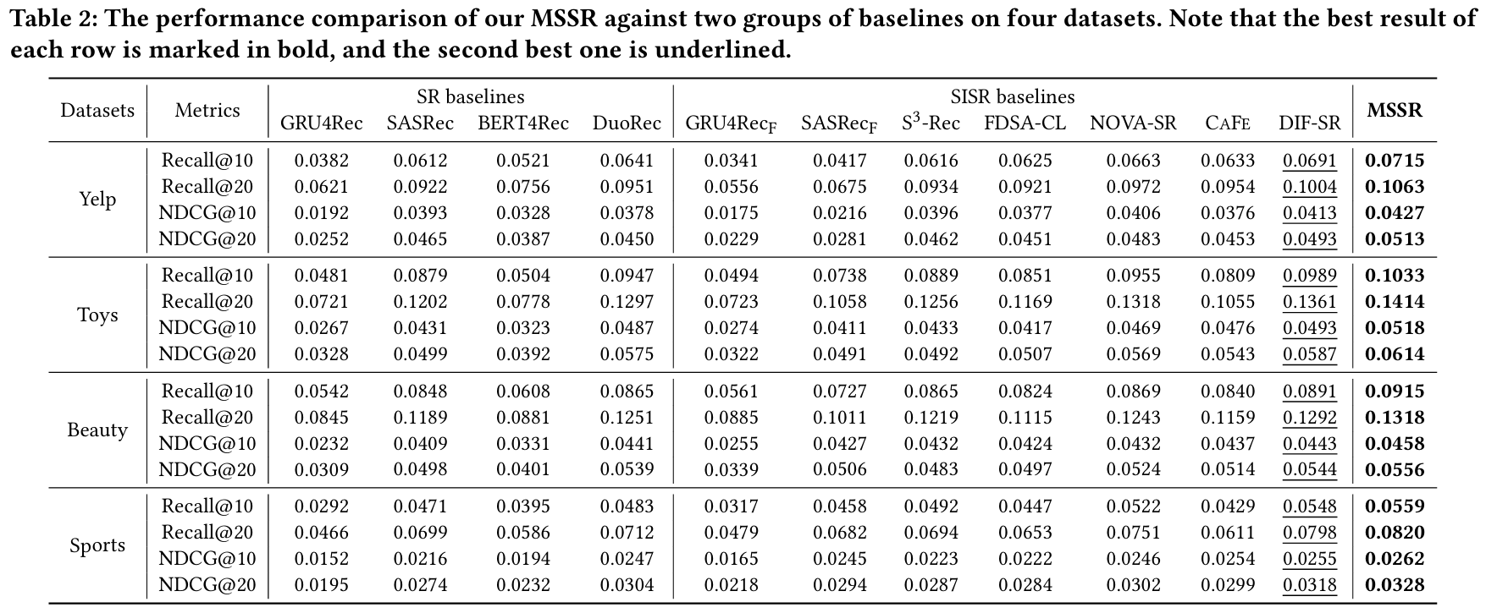
Experiments

Slide 11
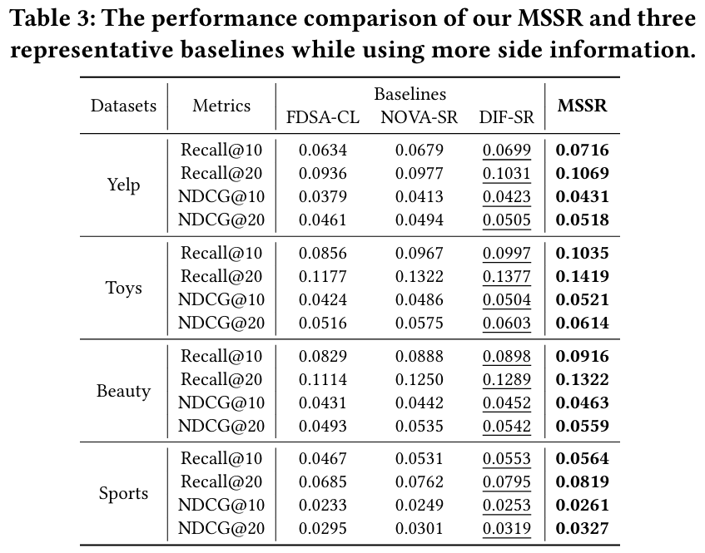
Experiments

Slide 12
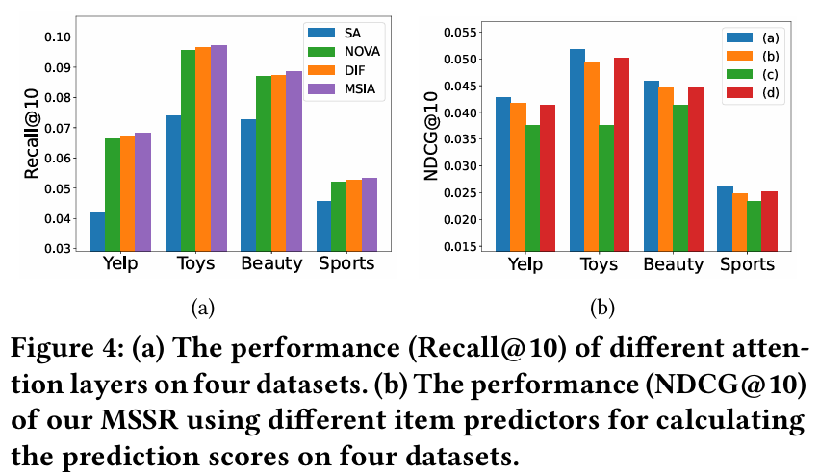
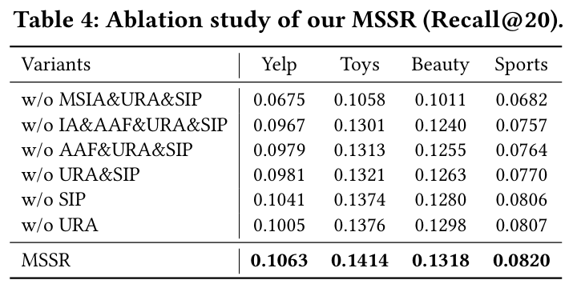
Experiments

Slide 13
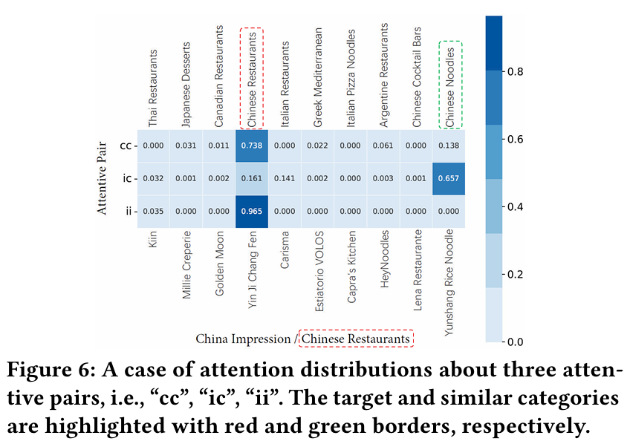
Experiments

Slide 14
Thanks!

